Slide 1
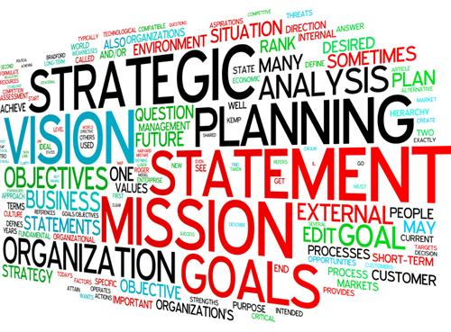
Suffolk County Community College
2020-2027 Strategic Plan

Slide 2
Why do we need a NEW Strategic Plan?
The current Strategic Plan was created for the 2007 Middle States Self-Study. The statement was reaffirmed during the 2011-2012 Strategic Planning process, resulting in the 2013-2020 Strategic Plan.
Changes in the landscape of higher education
  Cultural changes
    Technological advances
      Acceleration of a global economy
        Emerging demands in the workforce
          Increasing fiscal challenges

Slide 3
Why do we need a Strategic Plan?
To communicate our values, identity, goals, and aspirations to the College community, to stakeholders, and to the public at large.
To remain in compliance with SED, SUNY, and MSCHE requirements.
To guide decision-making over the next seven years, including actions/initiatives in annual operational planning.

Slide 4
Why do we need a Strategic Plan Cont.?
To form the basis of our integrated planning model that establishes the relationship between planning, assessment and evaluation, and budget/resource allocation – all tied back to our Institutional Goals.
To provide a framework for maintaining evidence of effectiveness for accreditation purposes.

Slide 5
Responsibility for Creating the
New Strategic Plan
Strategic Planning Committee
Representation from all campuses, faculty, staff, administration, students, academic programs, AES units.

Slide 6
Mission and Vision
Statement of Identity/Purpose and Statement of Aspirations
Institutional Goals
What we hope to accomplish based on the values expressed in the Mission and Vision Statements
Objectives
How we intend to meet those goals
Outcomes
What is accomplished if goals are met
Key Performance Indicators
Metrics used to gauge success

Slide 7
We begin the Strategic Planning process by identifying VALUES.
We do this by:
Seeking stakeholder perceptions of institutional strengths, weaknesses, opportunities, and threats (SWOT analysis).
Inviting all internal and external stakeholders to participate in the process.
The most frequently articulated values will inform the creation of the Mission Statement.

Slide 8
Strategic Plan 2020 – 2027
SCCC Stakeholders
Students | Staff | Faculty | Alumni | Administration | Feeder High Schools
Feeder Colleges and Universities | Employers of SCCC graduates | County Legislature | SCCC Retirees | Community Partners | Board of Trustees
Focus Groups
  One time, face-to-face sessions
  Last between 45 and 60 minutes
  Completely voluntary
  Participants must sign a consent form
  Focus groups are tape recorded
  Transcribed by the OPIE only

Slide 9
Strategic Plan 2020 – 2027
Tentative Focus Group Dates for Faculty
Grant Campus- Tuesday, October 23rd
Ammerman Campus- Wednesday, October 24th
Eastern Campus- Thursday, October 25th
Note: With the exception of Professional Development Day, all focus groups are currently scheduled from 11:00 a.m.-12noon. The schedule allows for additional faculty sessions to be added.

